Slide 1


Library Portal
Prepared By:
Name :- Soham Sabhaya
Roll no :- 309
Enroll No :- 23002171310163
Division :- B11
-

Slide 2
Project Outline :-
Purpose of the project
Class Diagram
Use case Diagram
Functionalities
Used Data Structures and class
Tools used
Merits & Demerits
Future Scope

Slide 3
Purpose of the Project
The Library Management System (LMS) is a Java and SQL based application designed to facilitate the management of library operations. It provides functionalities for both librarians and users, allowing them to efficiently manage books and user accounts.
Efficient Resource Management: Streamlines the organization and tracking of library resources, ensuring that books are easily accessible and accounted for.
User Convenience: Enhances user experience by providing a simple interface for searching, borrowing, and returning books, making it easier for users to find what they need.
Administrative Control: Empowers librarians with tools to manage user accounts and library inventory effectively, allowing for better oversight and control of library operations.Data Integrity: Ensures accurate record-keeping of book availability and user transactions, reducing errors and improving the reliability of library data.
Enhanced Security: Protects sensitive user information through secure login processes and controlled access to library resources.
Scalability: Provides a foundation for future enhancements, such as integrating additional features like online reservations, fines management, and digital collections.

Slide 4
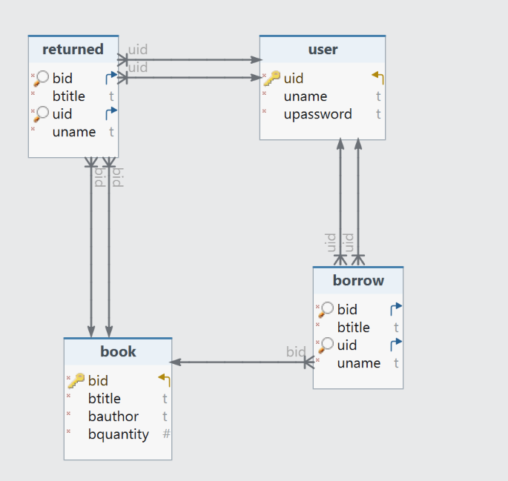
Class Diagram

Slide 5
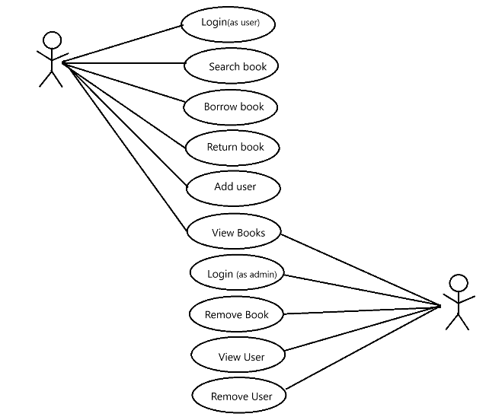
Use Case Diagram

Slide 6
Data Structures and Classes
Data Structure
Purpose
Queue
Classes
Maintaining Availability: The queue ensures that only available books (quantity > 0) are included. When a book is borrowed (borrowBook), its quantity is decremented, and it might be removed from the available books queue if it becomes unavailable (quantity reaches 0).
Efficiency: The queue provides efficient access to available books using FIFO (First-In-First-Out) principle. The first book added (enqueued) is the first one to be borrowed (dequeued). This can be helpful for managing book lending and ensuring fairness among users. In essence, the queue acts as a dynamic list that keeps track of books that are currently available for borrowing in the library
Represent different entities in the library system, encapsulating their attributes and behaviors.

Slide 7
Tools Used
MySQL
  The relational database management system used to store and manage the library's data, including user information, book details..
Visual Studio Code
The integrated development environment (IDE) used for writing, editing, and debugging Java code, providing a streamlined development workflow.

Slide 8
Merits & Demerits
Merits
Demerits
Structured Data Management
User-Friendly Interface
Scalability and Extensibility
Data Integrity and Security
Platform Independent
Concurrency
Limited user Interface
Limited functionality

Slide 9
Future Scope
Enhanced User Interface: Develop a visually appealing and user-friendly GUI or mobile app, making the system more accessible and intuitive.
Advanced Features: Implement features like reservations, recommendations, fines, event management, and integrations with other systems to provide a comprehensive library experience.
Improved Security: Enhance security by using role-based access control, encrypting sensitive data, and conducting regular security audits to protect against unauthorized access.
Scalability: Improve scalability by deploying the system on a cloud platform and optimizing database queries to handle large datasets efficiently.
Integration with Emerging Technologies: Explore the potential of AI and IoT to automate tasks, improve search functionality, and enhance user interactions.

Slide 10
Thank You

